Slide 1
Online Shopping Cart Project Code in Java using Eclipse
By Dinesh Nanda-1893551
&
AnkushPreet-1893728

Slide 2
1. This Code will ask the user to log in and then will ask about how many items he wants to buy, item name, its price and its quantity. 2. It will make the bills & display the total amount to the user including taxes. Discount feature is also added. In the end, it will ask the user either log out or continue shopping. 3. The program will continue to execute until the user doesn’t log out.
Objective

Slide 3
This program can be done by various methods. One of the methods is by giving static reference to attributes, methods. This project can also be done in various other languages like JavaScript, PHP, C, C++ etc.
Existing Solutions

Slide 4
This program uses multilevel inheritance approach. This code has been made by keeping simplicity in mind, so that it can be easily understood.
Approach

Slide 5
1. As stated, this program uses multilevel inheritance where each class inherits from its parent class except the one class. 2. The Code will ask for username & password to log in to the online shopping store and further ask for item name, its price and its quantity. It will display bills and discounts. 3. It uses six classes with methods in it and a scanner as well. Using these classes, objects are created and output is displayed.
Algorithm Design & its implementation

Slide 6
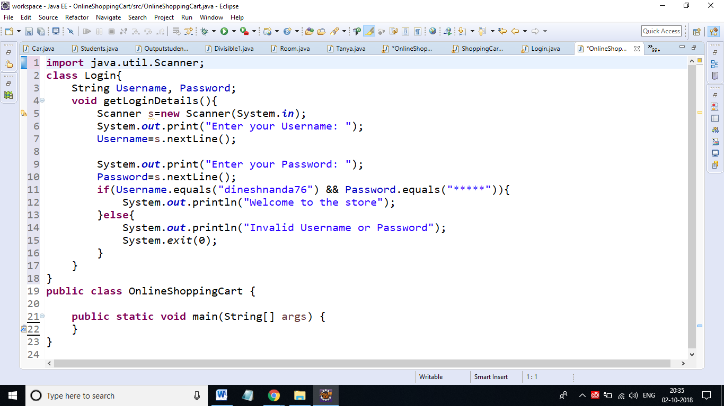

Slide 7
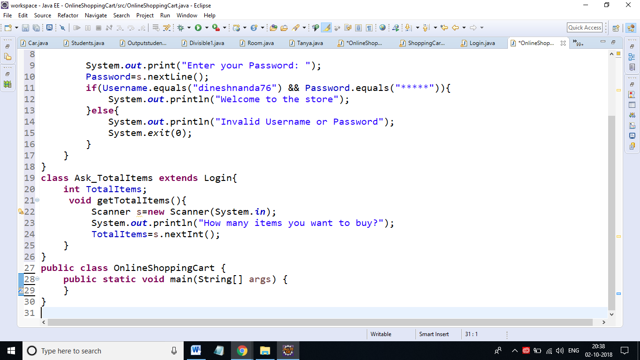

Slide 8
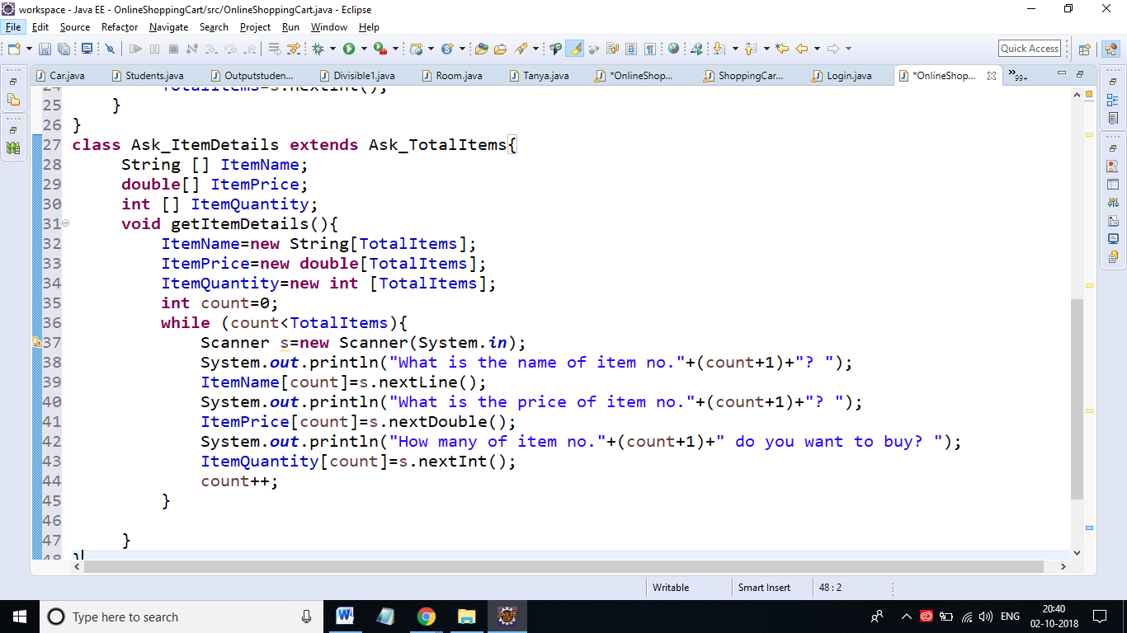

Slide 9
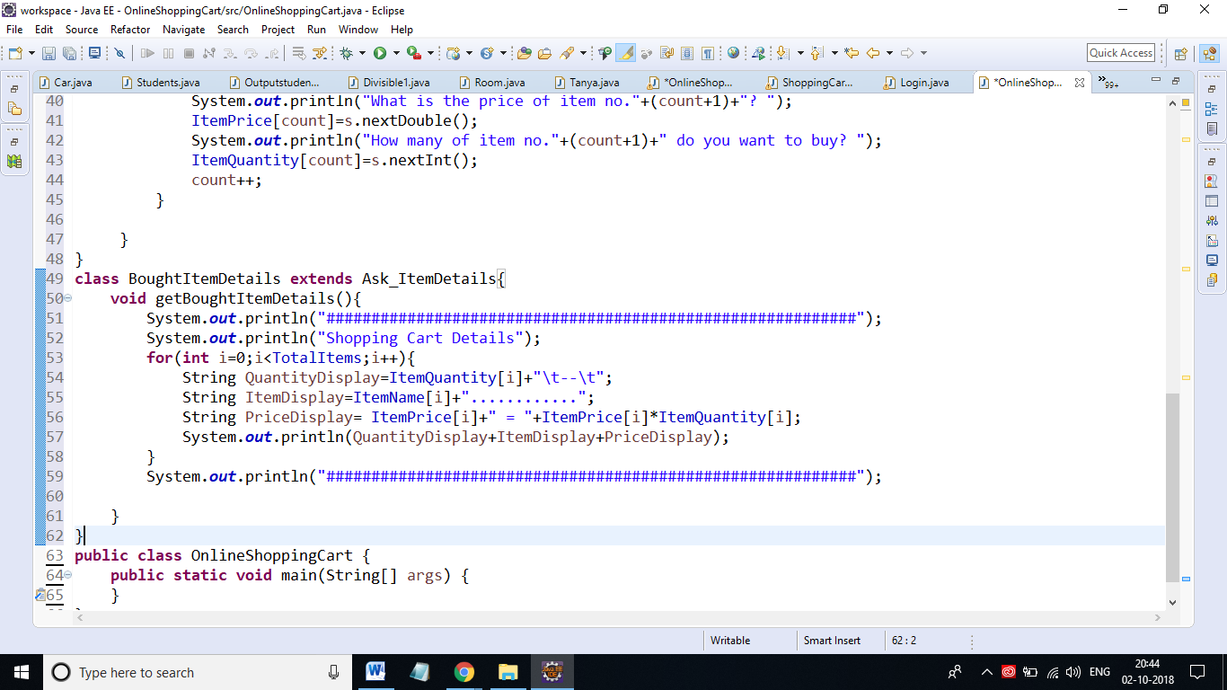

Slide 10
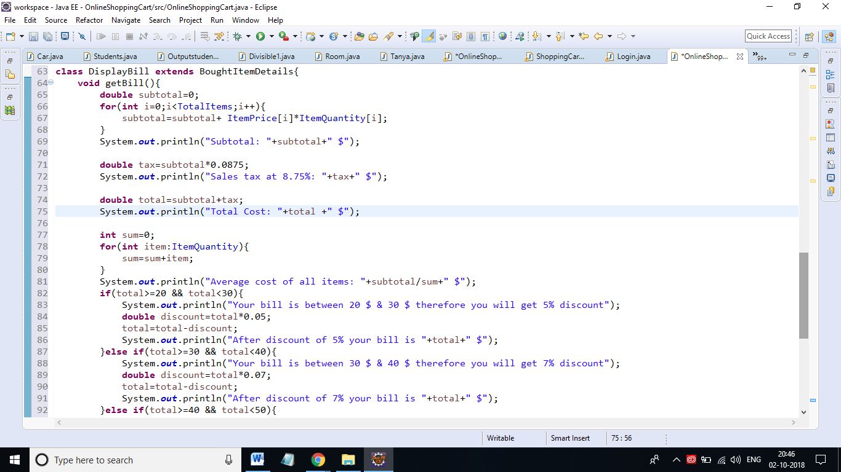

Slide 11
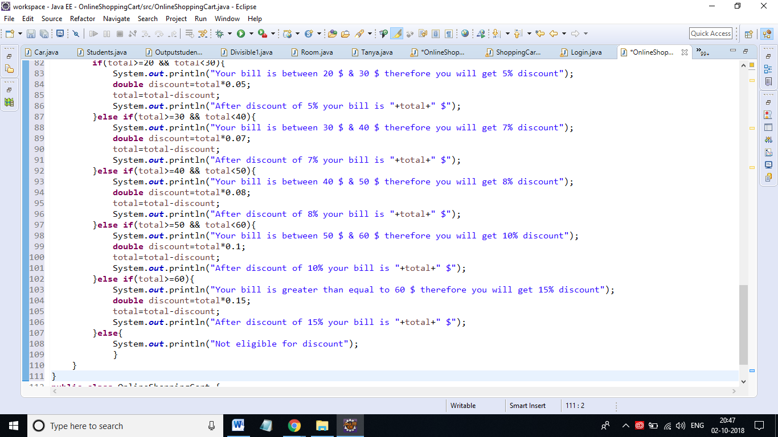

Slide 12
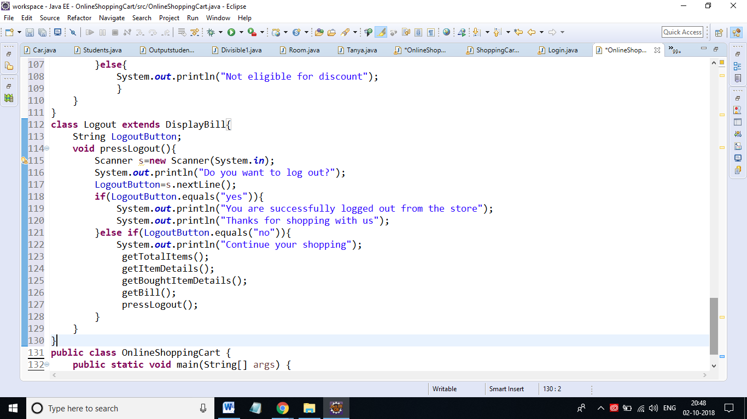

Slide 13
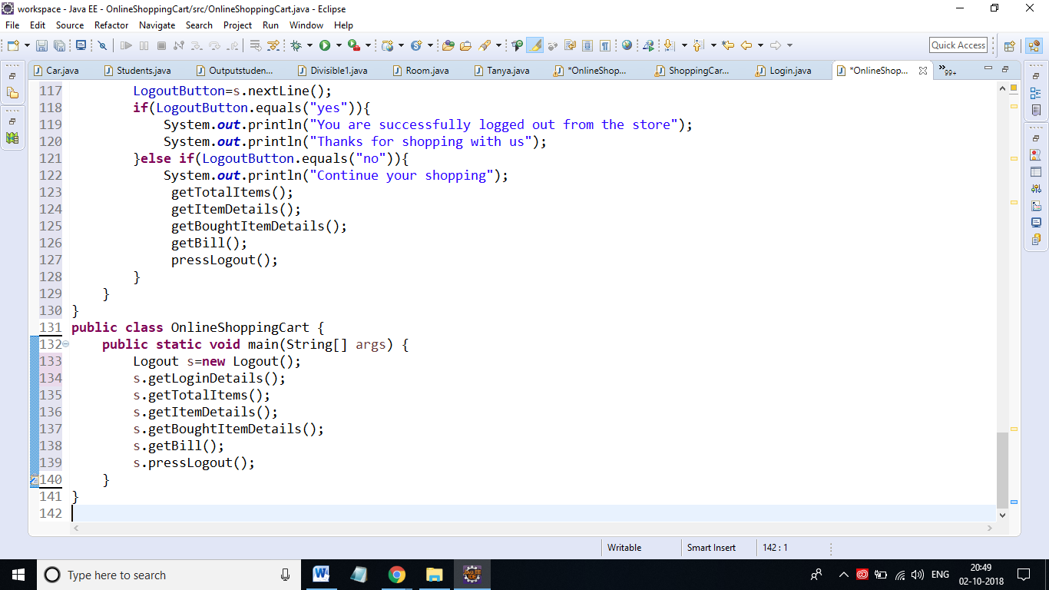

Slide 14
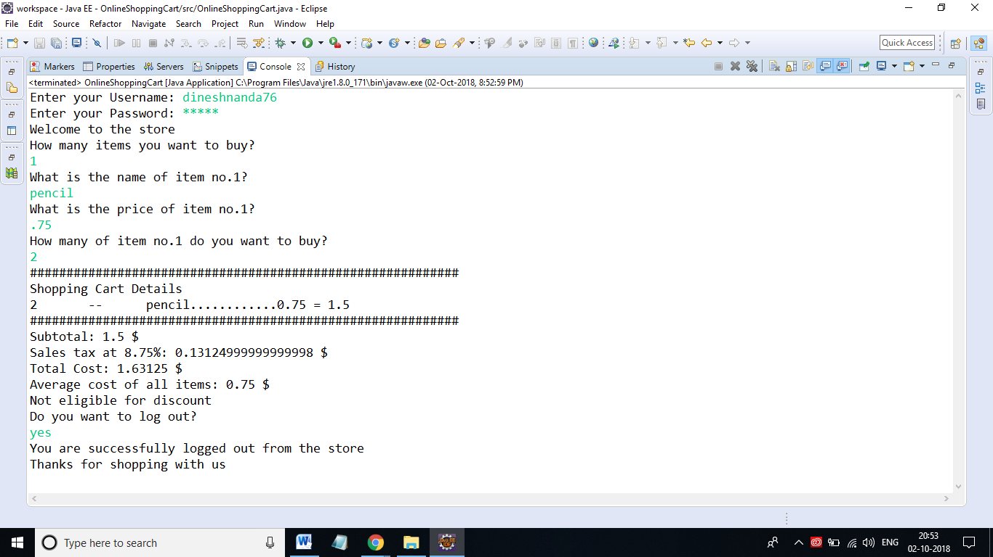

Slide 15
This online shopping cart enabled the user to tell the compiler how many items he/she wants to buy, item name, its price & quantity & in the end user will see the bill & might get discount depending upon the values he/she entered.
Conclusion

Slide 16
“Stay hungry, stay foolish” -Steve Jobs Thank you

